Slide 1
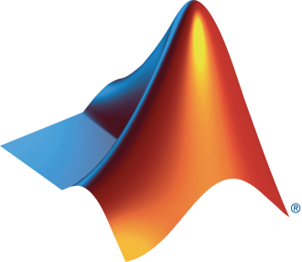

HPRC and MathWorks Present: Machine Learning Onramp

Slide 2
Today:
6:15 pm – 6.30 pm: Set-up
Intro to Machine Learning
Create MathWorks account
Log in to Machine Learning Onramp / Test MATLAB Online
6.30 pm – 8.00 pm: Machine Learning Onramp (on your own)

Slide 3
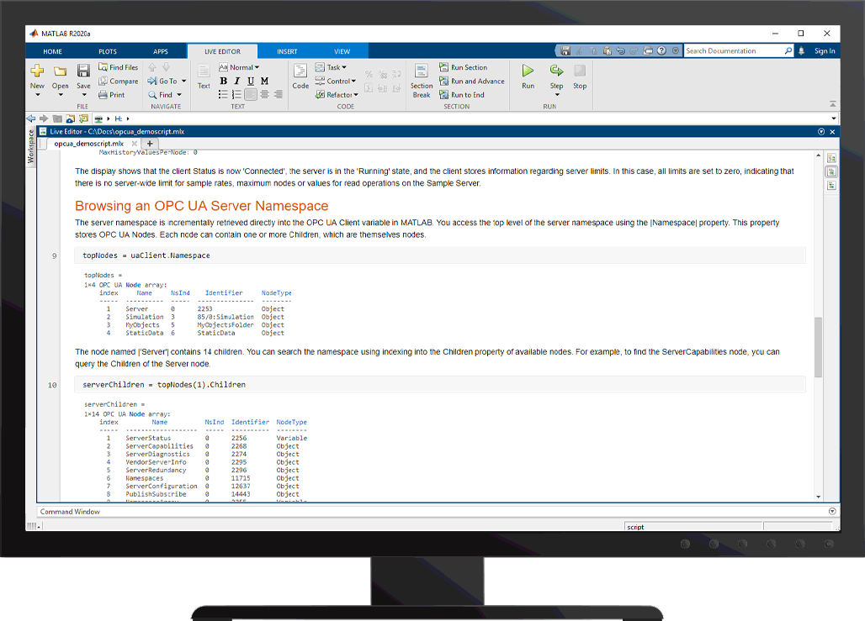

What is Machine Learning?
Process in which a computer uses statistics to find patterns within data sets
The patterns found can be used to classify future data sets
Machine learning at work:
Unlocking a phone with facial or fingerprint recognition
Video streaming sites recommending similar videos
Social media filters knowing where faces are in a frame

Slide 4



Types of Machine Learning
Unsupervised
Supervised
Group and interpret data based only on input data
Develop predictive model based on both input and output data
Clustering
Classification
Regression
Classify each data point into a specific group
Predict by separating the data into multiple categorical classes
Predict by distinguishing the data into continuous real values
Notes:
Unsupervised learning finds hidden patterns in data. It is used to draw inferences from datasets consisting of input data without labeled responses.
The aim of supervised learning is to build a model that makes predictions based on evidence in the presence of uncertainty. A supervised learning algorithm takes a known set of input data and known responses to the data (output) and trains a model to generate reasonable predictions for the response to new data.

Slide 5
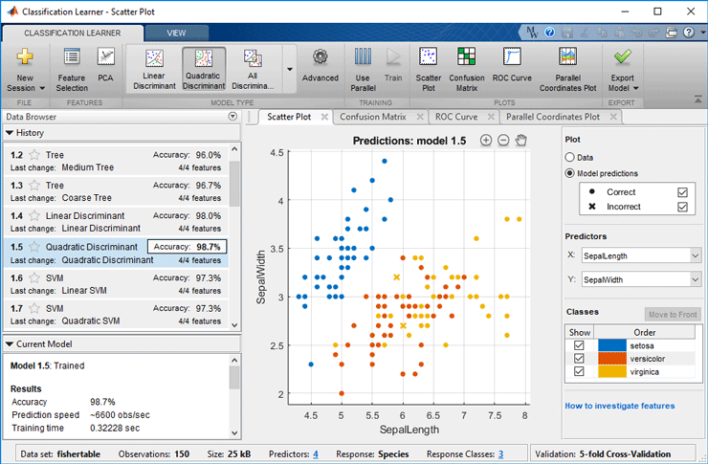
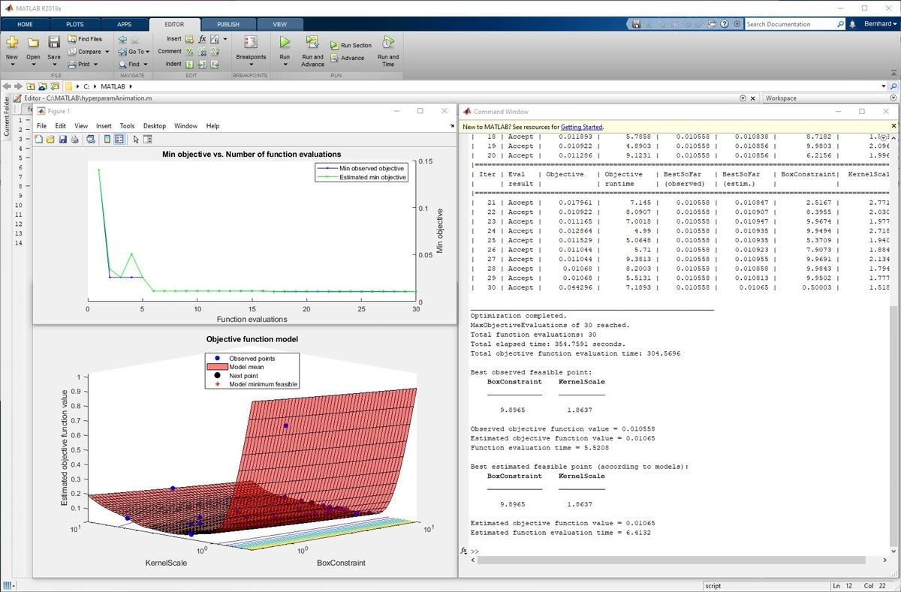
Machine learning with MATLAB
Choose from popular machine learning algorithms, train models, tune and export all interactively
Generate and embed C/C++ code for machine learning algorithms
Speed up statistical computations and model training with parallel computing
Use tall arrays to train machine learning models on data sets too large to fit in machine memory

Slide 6
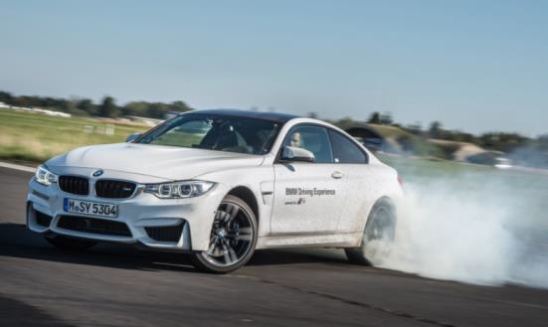
What can I do with Machine Learning? BMW Uses Machine Learning to Detect Oversteering
Challenge
Develop automated software for detecting oversteering, an unsafe condition in which rear tires lose their grip during a turn
Solution
Use MATLAB to develop, train, and evaluate a variety of supervised machine learning classifier types, including KNN, SVM, and decision trees
Results
Oversteering identified with greater than 98% accuracy
Multiple machine learning classifiers trained automatically
Code generated and deployed to an ECU for real-time, in-vehicle testing
A BMW M4 oversteering on a test track.
Link to article

Slide 7
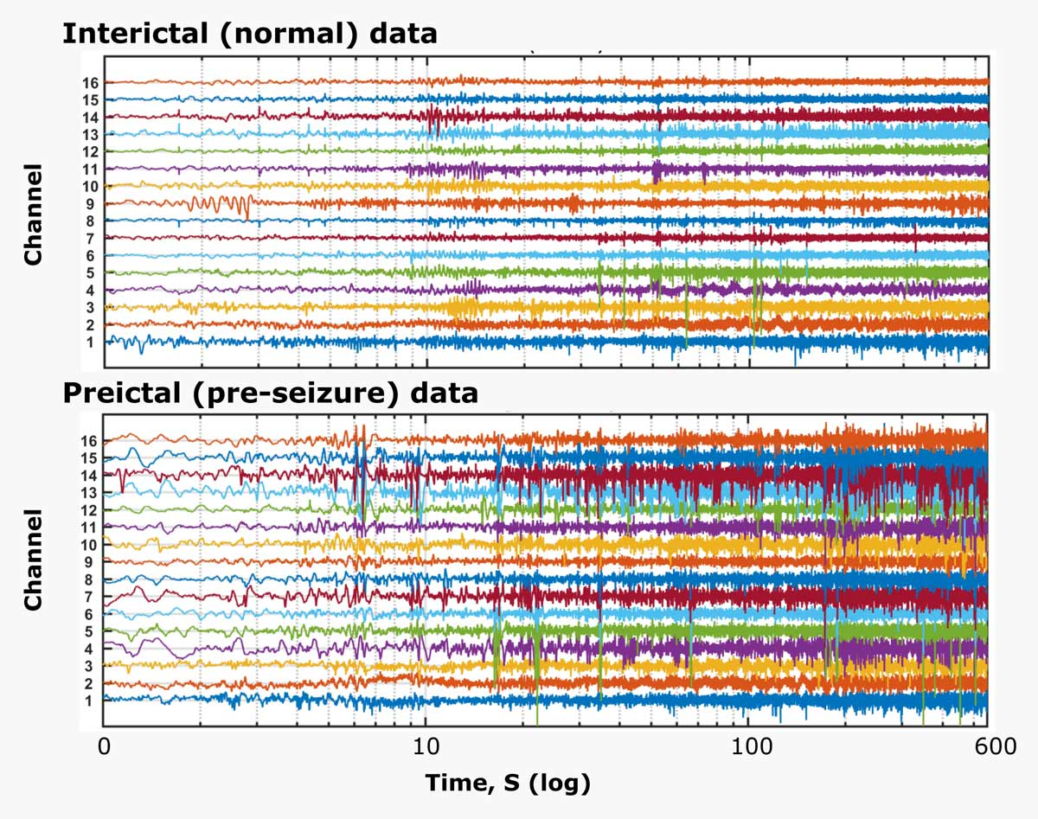
What can I do with Machine Learning? University College of London Researcher Uses Machine Learning to Predict Epileptic Seizures from EEG Data
Challenge
Develop algorithms that can predict the onset of epileptic seizures based on human intracranial electroencephalograph (EEG) recordings
Solution
Use MATLAB to extract features from the data, identify the best classification models, and combine models to maximize prediction accuracy
Results
Created model for predicting epileptic seizure for multiple patients
Developed algorithms that won first place for individual participants and third place overall in a worldwide Kaggle competition
Halved computation time by simultaneously processing training and test data on multiple cores
Intracranial EEG data analyzed with machine learning algorithms
Link to article

Slide 8


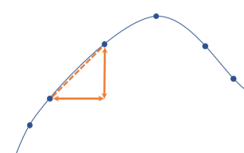
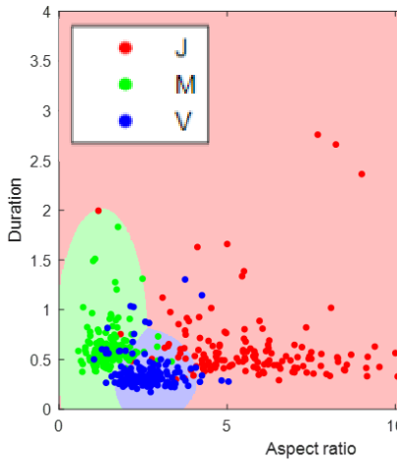
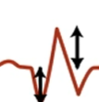
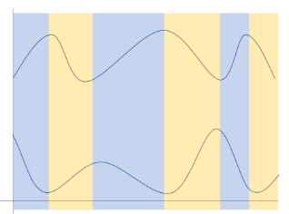
Machine Learning Onramp
Free, short course on practical machine learning techniques for classification
Short videos, hands-on exercises, automated assessments, & immediate feedback
Learn by working through an example of detecting letters by analyzing writing motion
Topics include:
Overview of classification workflow
Importing data using datastores
Engineering features
Automating feature extraction
Training and evaluating models
Visit https://www.mathworks.com/tutorials for more details
m

Slide 9
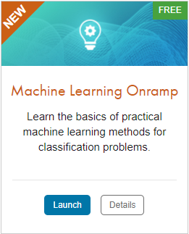
TO DO
Go to https://matlabacademy.mathworks.com/
Log in to your MathWorks account
Launch Machine Learning Onramp

Slide 10
Prizes
Complete at least 50% of Machine Learning Onramp to be eligible for any prize
Bring your laptop when you come to collect the prize
Follow Us on Facebook!
Find us on Facebook at [Insert Facebook Group Name]

